Slide 1
Main Storyline So Far
Joren Janzing
30-5-2022

Slide 2
What is the mechanism that leads to warm and cold events in the model?

Slide 3
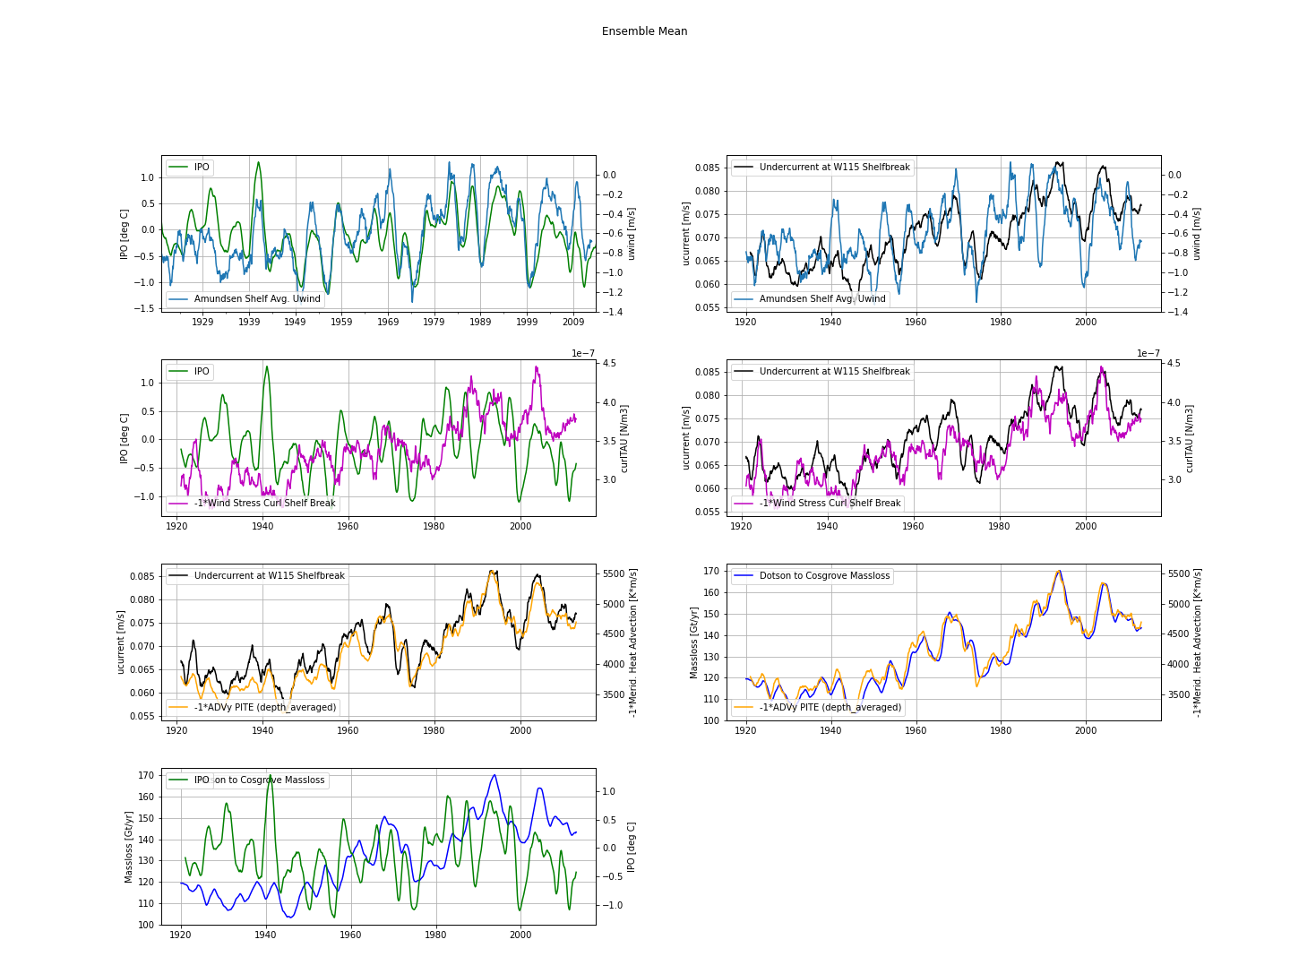
In ensemble mean:
Strong correlation between IPO and shelf break zonal wind
However, weaker relation between wind and undercurrent.
Better correlation surface stress curl and undercurrent.
Strong relation between undercurrent, heat advection and melt.
Not a strong relation between IPO and surface stress curl, undercurrent, heat advection and melt.
Weak response in 1940s for melt.
Wishlist:
Quantify it: correlation coefficient!
Proper way to show the individual ensemble members

Slide 4
Velocity with Melt

Slide 5
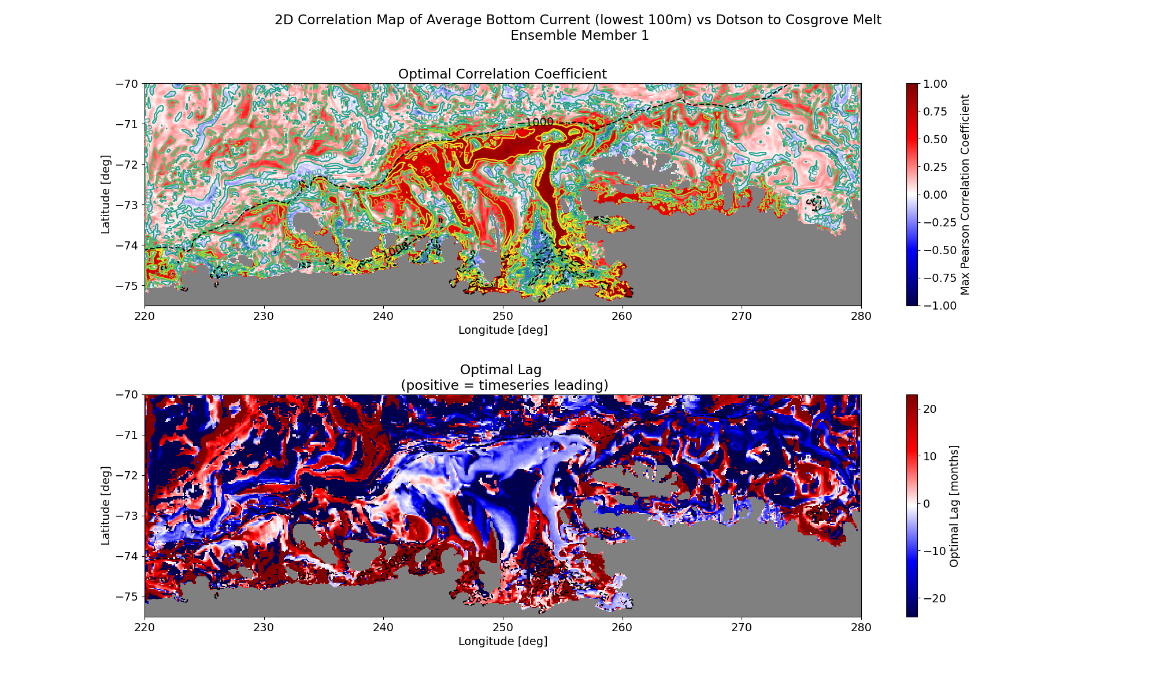

Slide 6
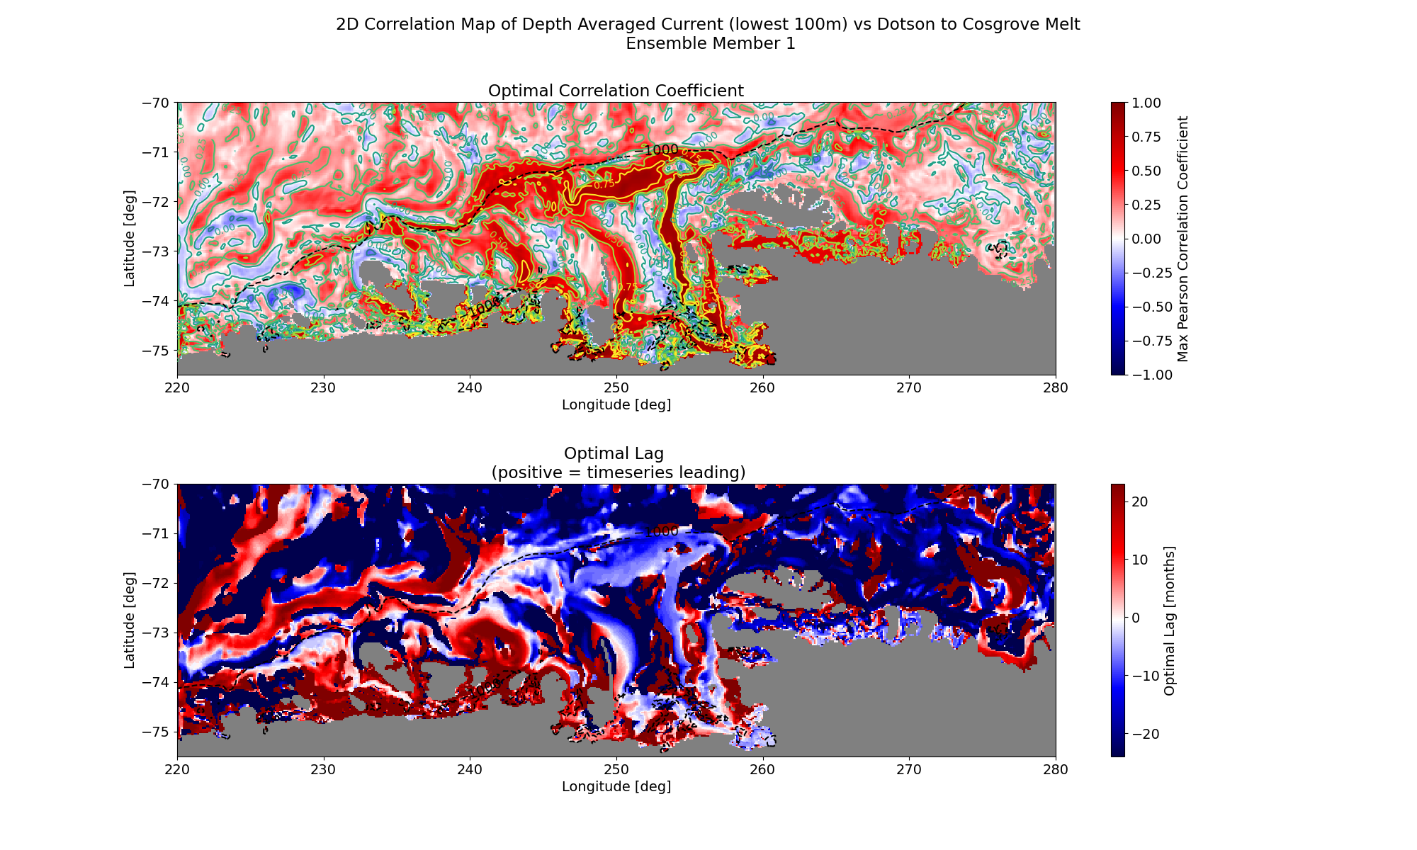

Slide 7
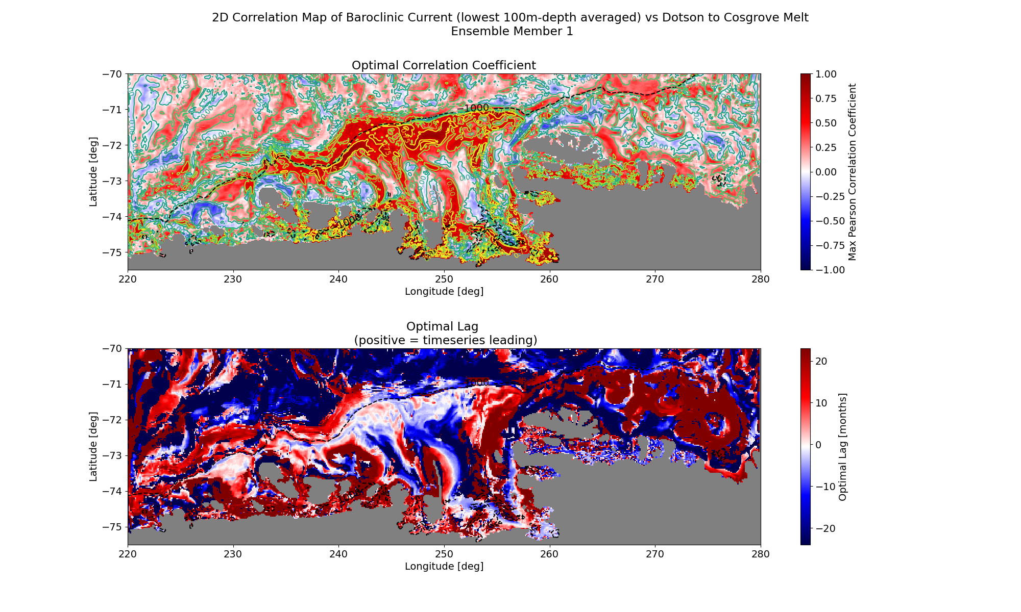

Slide 8
Velocity with Wind (is approximately IPO)

Slide 9
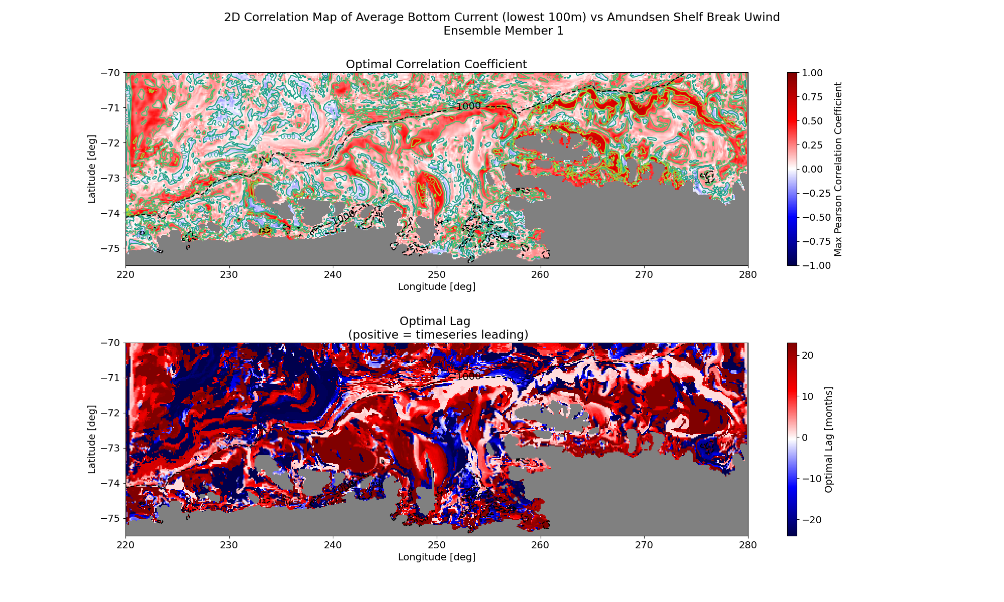

Slide 10
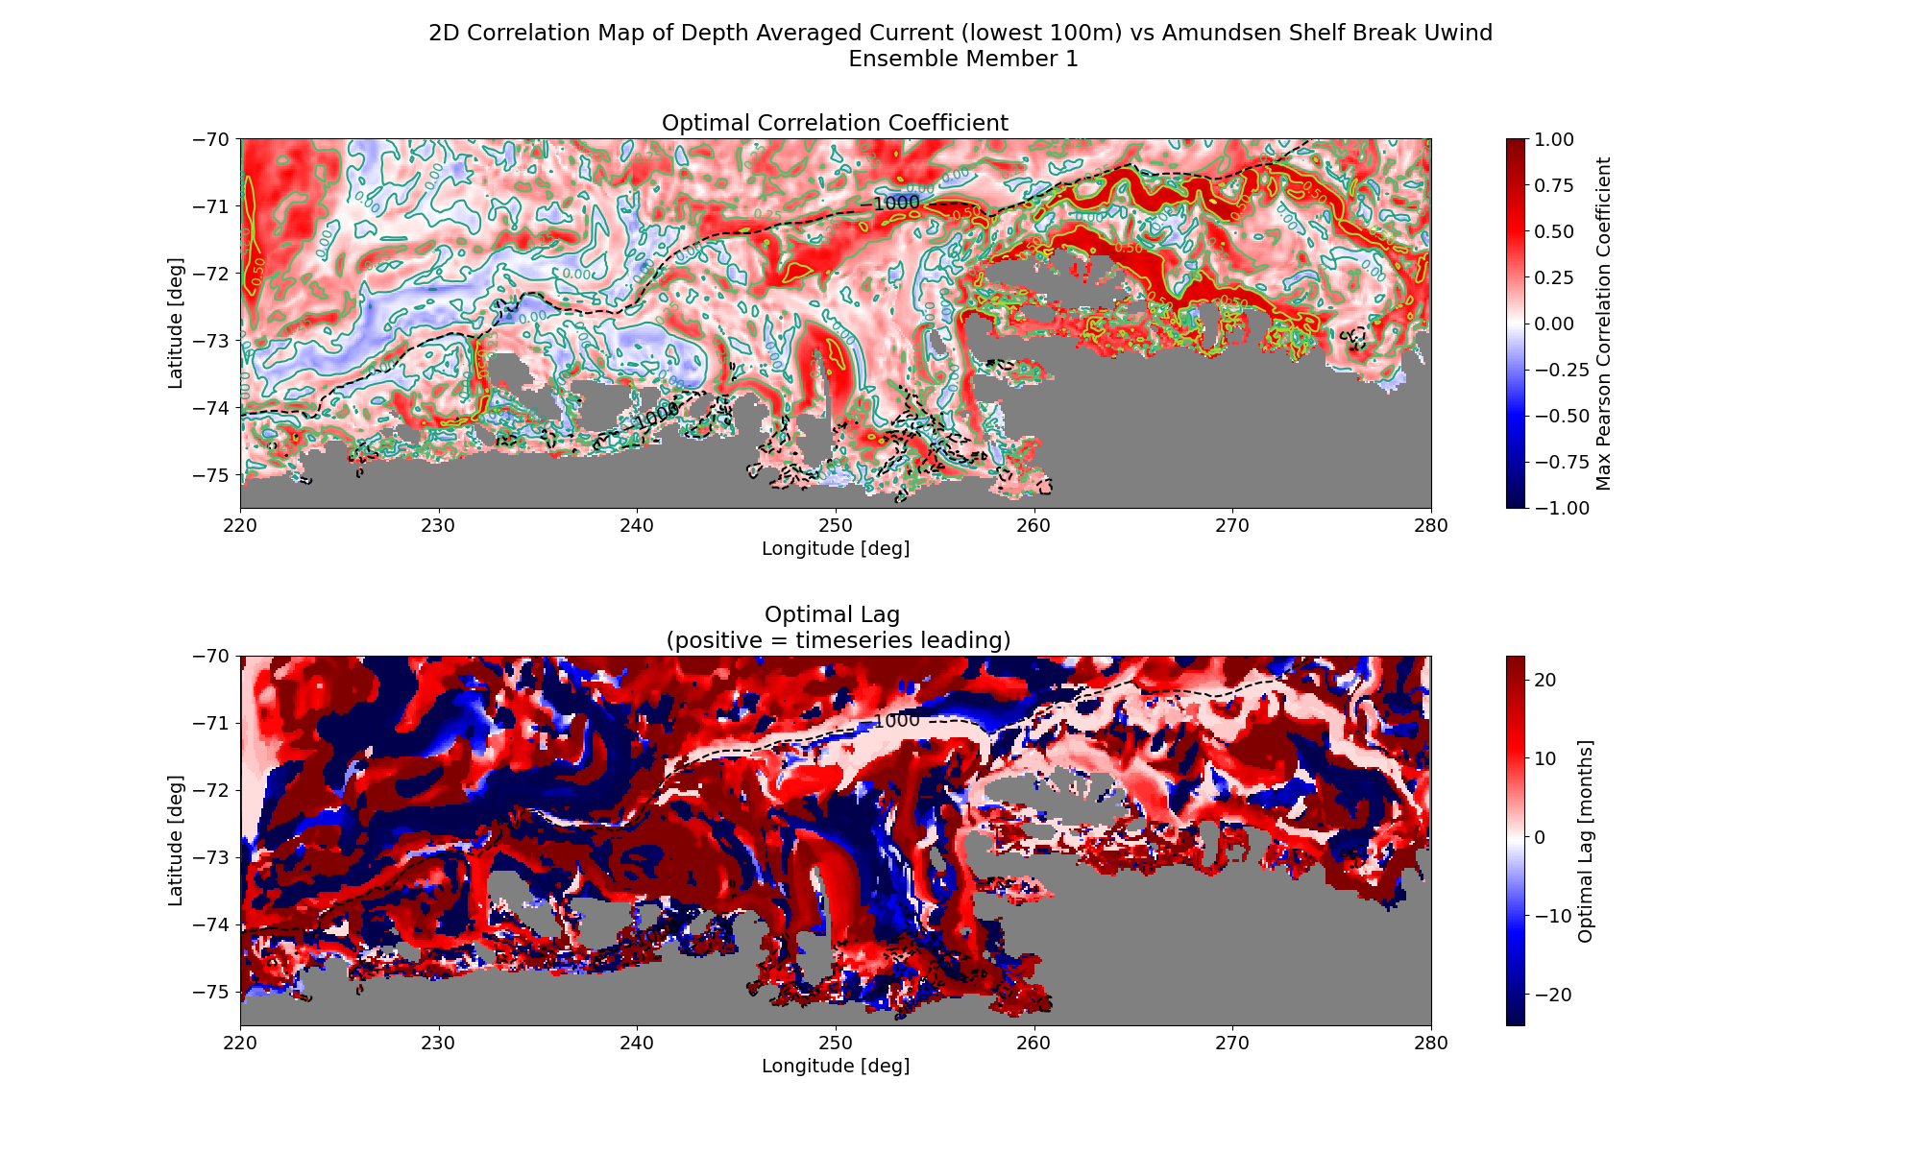

Slide 11
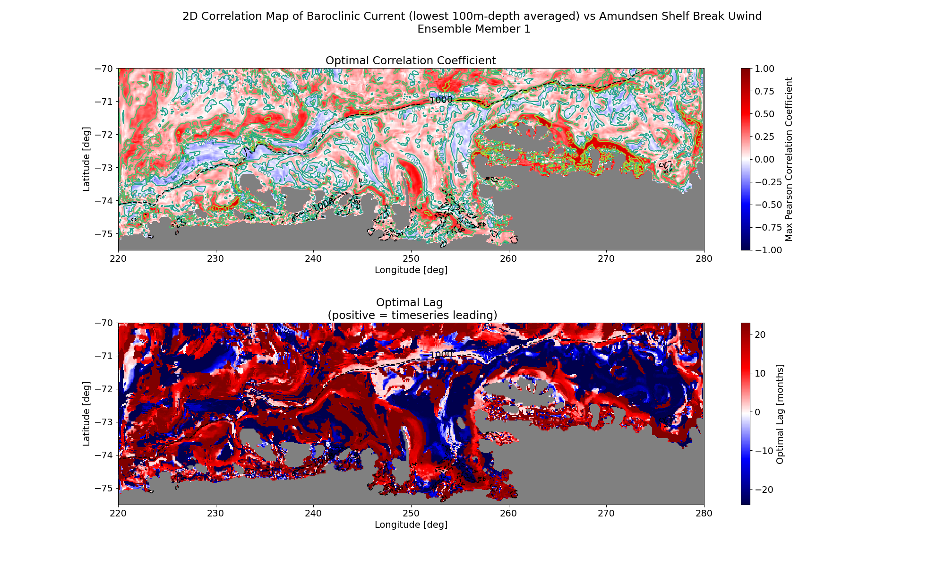

Slide 12
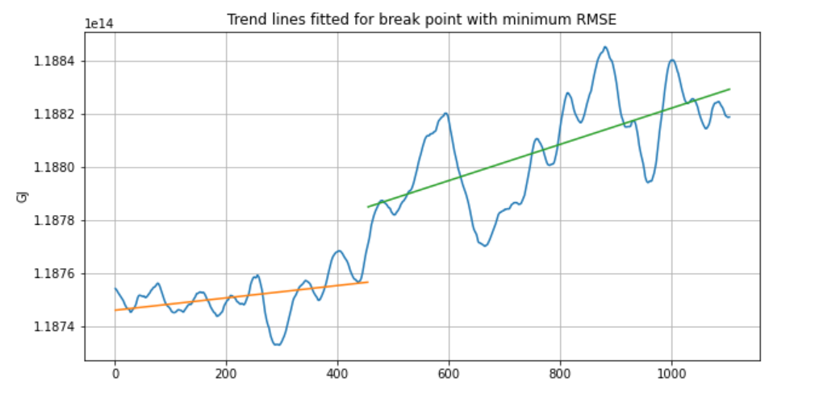
In ensemble mean:
There seems to be a trend break point around 1958.
Wish list:
Even though the method seems okay, just eyeballing it I would put the trend break earlier.
Add years on the x-axis, stupid! And while you are at it, add a line indicating the trend break.

Slide 14
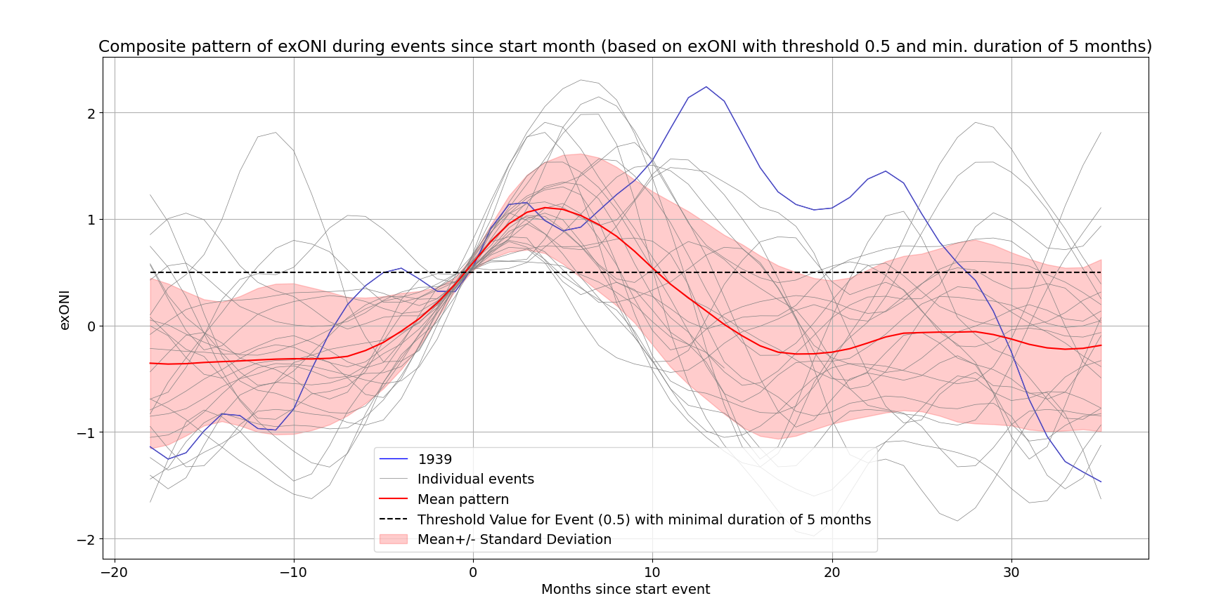
Why is the 1940s response in the model so weak?
The 1940s saw the longest El Niño in the 20th century, but the melt response in the ensemble mean is weak.

Slide 15
Explanation 1
Whereas the zonal wind responds directly to the IPO, melt shows a cumulative response. This therefore also includes the effect of the surrounding ENSO events, which are clearly not as strong.

Slide 16
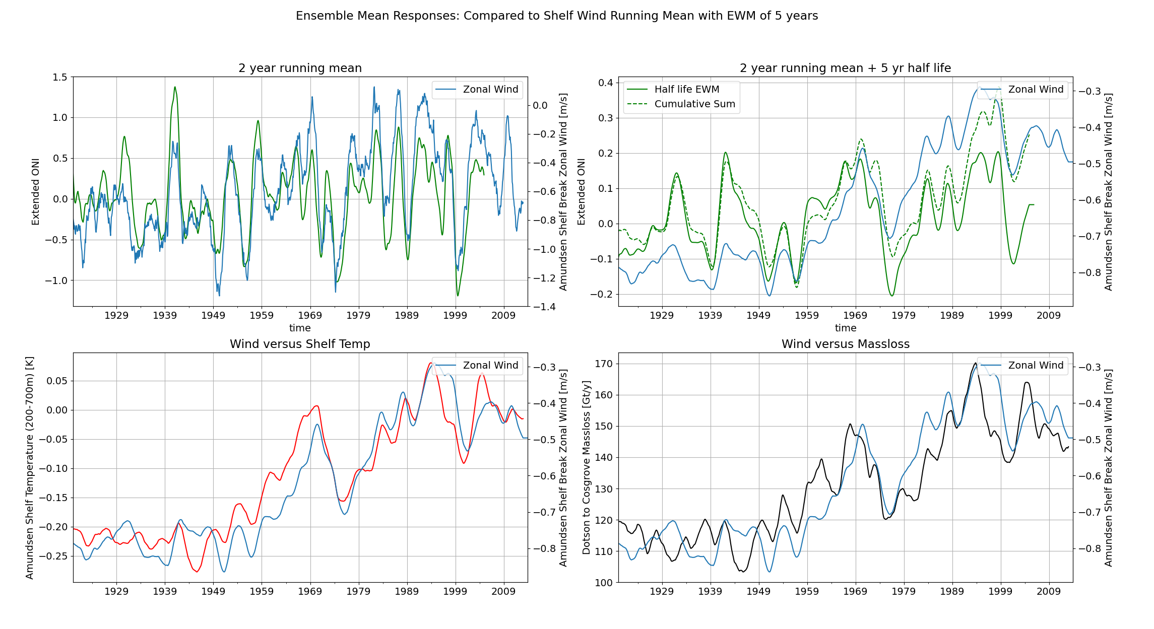
In ensemble mean:
There seem to be two types of responses in the model: - an instantaneous response - an integrated response, which is also somewhat present in the IPO.
The integrated wind response is already clearly weaker than the instantaneous response.

Slide 17
Explanation 2
Convection events ‘mask’ the 1940s ENSO response.
We see that members with a strong response in the 1940s do not show convection events at the same time (obvious).
If we remove all members with convection events before and after the 1940s ENSO event, than the 1940s anomaly becomes more pronounced in the ensemble mean.

Slide 18
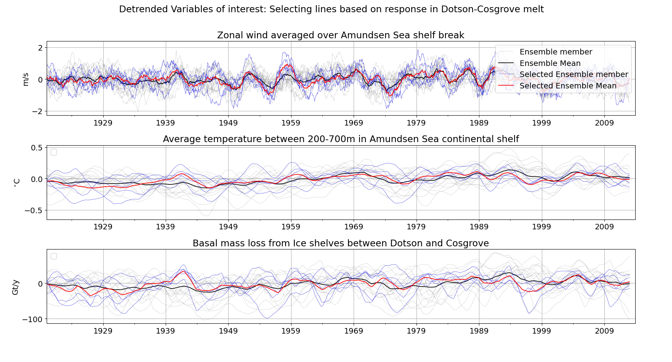

Slide 19
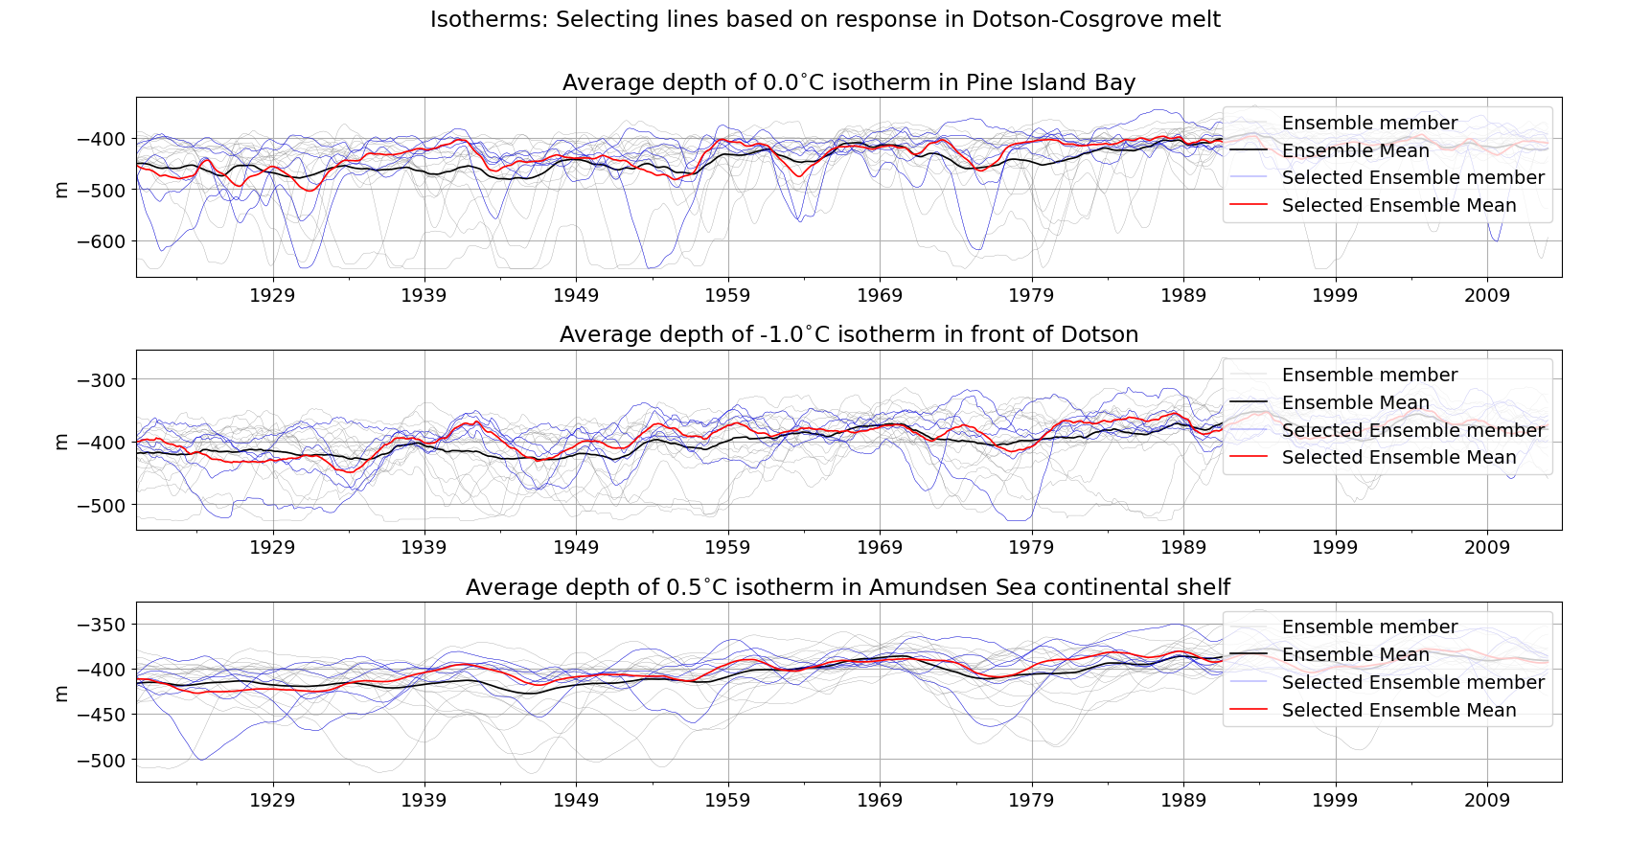
What do they have in common?

Slide 20
